Slide 1
BLAZE ACADEME
DIGITAL STUDIO

Slide 2

Problem
LACK OF

Slide 3

Solution
BLAZE
Academe

Slide 4
What is BLAZE?
Building
Leaders
And
Zeal
Entrepreneurs

Slide 5
WHO IS BLAZE ACADEME?
It is called an “Academe” because blaze offers an academic environment and community that develops leaders and zeal entrepreneurs.
Blaze Academe teaches and encourages people on how to make the most of their passion and talents and skills that can be montezed.

Slide 6
WHO IS BLAZE ACADEME?
It also offers mentorship programs and coaching sessions that will amplify the skills and talents of membes.
We also teach people how to properly trade and invest in crypto currencies.
We offer proper training on how to progress from being an ordinary person to becoming an outstanding entrepreneur in the future.

Slide 7
MISSION
To inspire individuals in pursuing their aspirations in their chosen career and interests with a sense of purpose.

Slide 8
VISION
To be known as the prominent platform that discovers talented and passionate people which will give significant impact on people who want to make difference in other people’s lives.

Slide 9
CORE VALUES
Integrity
Leadership
Passion
Teamwork
Empowerment
Excellence
Mentorship
Growth
Discipline
Balance

Slide 10
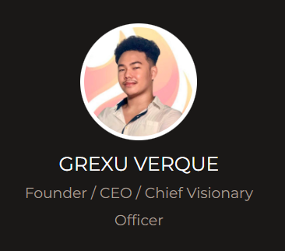
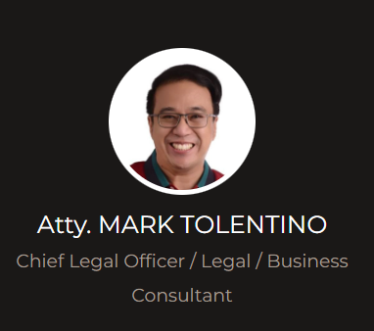
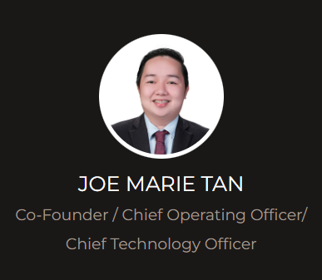
Executive Team

Slide 11
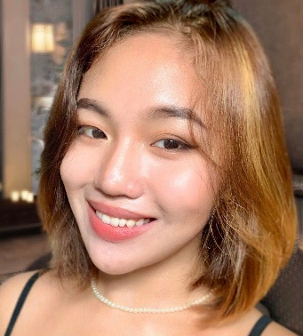

Executive Team
ANNE VERNQUE
Chief Marketing Officer

Slide 12
Packages
Bronze Cart (Php20,000)
  -APLGO Promoter package
  -Royal Q 1 Year Subscription
  -Premium Vouch Card (No Expiry)
  -Php50 daily virtual voucher for 30 days

Slide 13
Packages
Silver Cart (Php30,000)
  -APLGO Promoter package
  -Royal Q 1 Year Subscription
  -Premium Vouch Card (No Expiry)
  -Php100 daily virtual voucher for 30 days
  -Mentorship Course with Josh Vasquez and other coaches

Slide 14
Packages
Gold Cart (Php40,000)
  -APLGO Promoter package
  -Royal Q 1 Year Subscription
  -Premium Vouch Card (No Expiry)
  -IMG Insurance – Kaiser
  -Php150 daily virtual voucher for 30 days
  -Special Mentorship Course

Slide 15
Packages
Titanium Cart (Php50,000)
  -APLGO Promoter package
  -Royal Q 1 Year Subscription
  -Premium Vouch Card (No Expiry)
  -IMG Insurance – Kaiser
  -Php150 daily virtual voucher for 30 days
  -Special Mentorship Course
  -NFT worth of Php10,000

Slide 16
Payment Methods
Bank Transfer/Deposit
  Bank of the Philippine Islands
Other Methods
  Gcash
  CSS (CoinSwapSpace)
  UTED (United)
  BCP (BitCashPay)
  LGX (LegionNetwork)

Slide 17
How to become a Blaze Member?
Pay Php1,000 or $20 for lifetime access to our online and offline programs.
1 Clear Valid ID
Selfie while holding your ID

Slide 18
Complete your Membership!
Step 1 – Need to contact our support Team on this link: https://www.facebook.com/BLAZE-Academe-Support-101728752236210

Slide 19
Step 2 – Ask the Support Agent where you can pay for the membership fee
Step 3 – Send proof of payment receipt/invoice to our Academe Page
Step 4 – Send your clear valid ID/Student ID to our Support Academe Page
Step 5 – Send your clear selfie while holding your valid ID
Step 6 – Once done, wait for the qualification confirmation.

Slide 20
What’s in it for you?
Discounts on our Crypto Educational Session Modules
1 Affordavouch worth Php499.00 valid for 1 year
1 BLAZE Dry fit T-Shirt (Any sizes)
1 Physical ID for BLAZE
Basic Crypto Education (Scheduled)
Entrepreneurship Education (Scheduled)
Life Coaching (Scheduled)
Health and Wellness Education (Scheduled)
Discounts on Basic Law Education (Scheduled)
Discounts on BLAZE Shop
Free Access to our Facebook Group Page
Free Access to our Discord and Telegram Group
Discounts on BLAZE Academe Merchandise

Slide 21
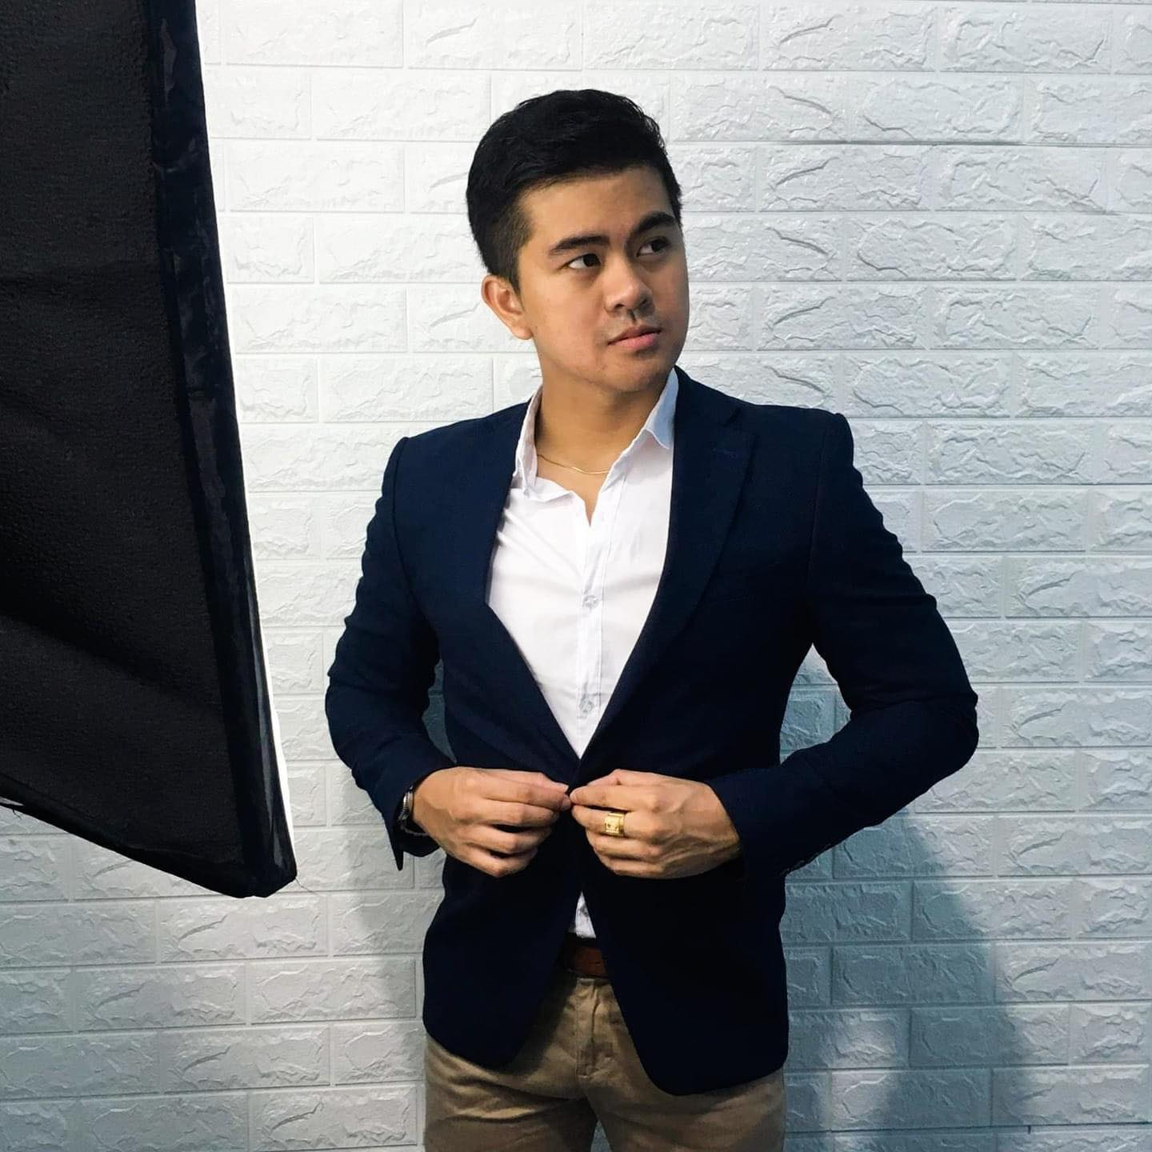
Mentorship
The Josh Mentorship Program

Slide 22

Coaching Sessions
Better U Coaching Community

Slide 23
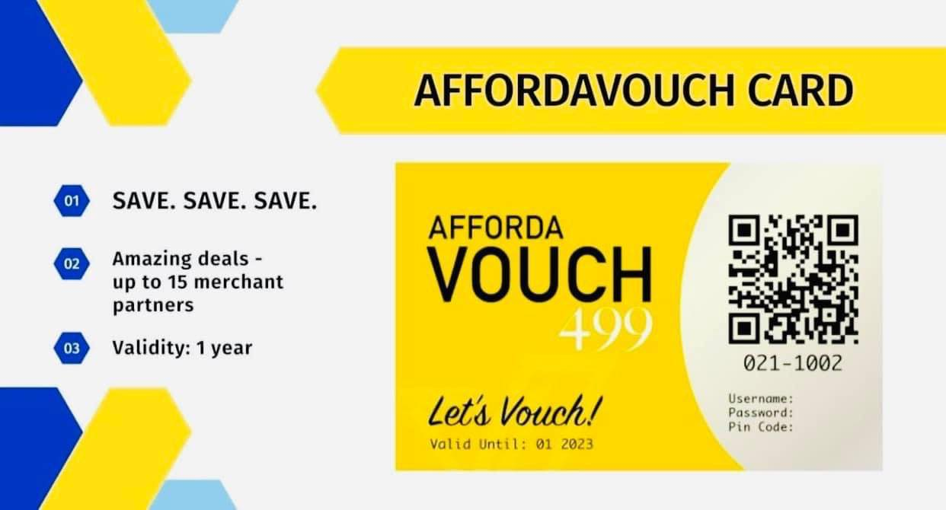
Affordavouch
https://vouchph.wixsite.com/flashsale

Slide 24

BLAZE Cares
1% of Php1,000 or $20 membership fee will be donated to our non-profit organization and charity foundation to help people in need.
You may also send your donations on our Facebook Page: https://www.facebook.com/BLAZE-Cares-102493225491907/.
Other % will be used to develop our community and expand future benefits.

Slide 25
RoadMap
Q4: 2019 - BLAZE Cares Founded
Q2: 2020 - 10 members
Q3: 2020 - Charity Distribution
Q4: 2020 - 50 members
Q1: 2021 - Charity Distribution
Q2: 2021 - Start of Membership Fees
Q3: 2021 - 100 members
Q4: 2021 - Charity Distribution
Q1 : 2022 - 500 members
Q2: 2022 - Virtual ID membership app
Q3: 2022 - 2,000 members
Q4: 2022 - Charity Distribution

Slide 26
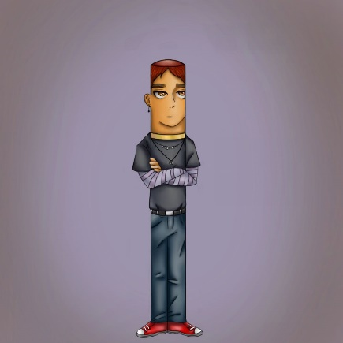
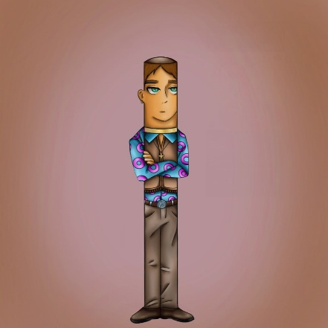
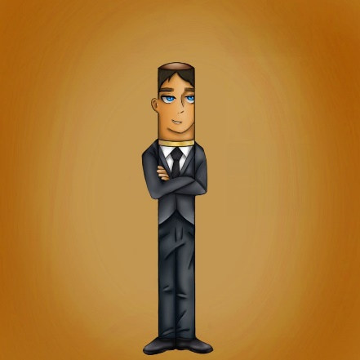
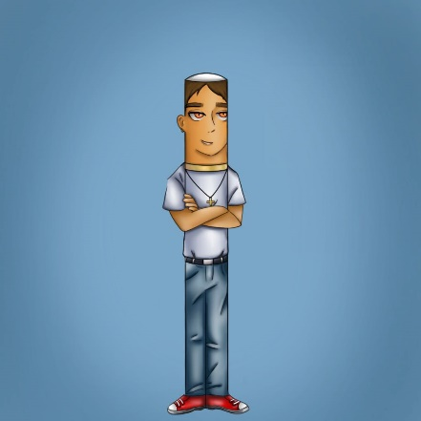
NFT (Non-Fungible Token)
A non-fungible token is a non-interchangeable unit of data stored on a blockchain, a form of digital ledger. Types of NFT data units may be associated with digital files such as photos, videos, and audio. Because each token is uniquely identifiable, NFTs differ from blockchain cryptocurrencies, such as Bitcoin.

